Slide 1
GUI Using Python

Slide 2
Recommended Version: 2.7 or latest
Source :
http://www.tutorialspoint.com/python/python_gui_programming.htm

Slide 3
Tkinter: Tkinter is the Python interface to the Tk GUI toolkit shipped with Python. We would look this option in this chapter.
wxPython: This is an open-source Python interface for wxWindows
JPython: JPython is a Python port for Java which gives Python scripts seamless access to Java class libraries on the local machine

Slide 4
Tkinter Programming
Tkinter is the standard GUI library for Python. Python when combined with Tkinter provides a fast and easy way to create GUI applications. Tkinter provides a powerful object-oriented interface to the Tk GUI toolkit.
Creating a GUI application using Tkinter is an easy task. All you need to do is perform the following steps −
  Import the Tkinter module.
  Create the GUI application main window.
  Add one or more of the above-mentioned widgets to the GUI application.
  Enter the main event loop to take action against each event triggered by the user.

Slide 5
Program1
#!/usr/bin/python
import Tkinter
top = Tkinter.Tk()
# Code to add widgets will go here...
top.mainloop()

Slide 6
Tkinter Widgets
Tkinter provides various controls, such as buttons, labels and text boxes used in a GUI application. These controls are commonly called widgets.
There are currently 15 types of widgets in Tkinter. We present these widgets as well as a brief description in the following table −

Slide 7
Operator | Description
Button | The Button widget is used to display buttons in your application.
Canvas | The Canvas widget is used to draw shapes, such as lines, ovals, polygons and rectangles, in your application.
Checkbutton | The Checkbutton widget is used to display a number of options as checkboxes. The user can select multiple options at a time.
Entry | The Entry widget is used to display a single-line text field for accepting values from a user.
Frame | The Frame widget is used as a container widget to organize other widgets.
Label | The Label widget is used to provide a single-line caption for other widgets. It can also contain images.
Listbox | The Listbox widget is used to provide a list of options to a user.
Menubutton | The Menubutton widget is used to display menus in your application.
Menu | The Menu widget is used to provide various commands to a user. These commands are contained inside Menubutton.
Message | The Message widget is used to display multiline text fields for accepting values from a user.
Radiobutton | The Radiobutton widget is used to display a number of options as radio buttons. The user can select only one option at a time.
Scale | The Scale widget is used to provide a slider widget.
Scrollbar | The Scrollbar widget is used to add scrolling capability to various widgets, such as list boxes.
Text | The Text widget is used to display text in multiple lines.
Toplevel | The Toplevel widget is used to provide a separate window container.
Spinbox | The Spinbox widget is a variant of the standard Tkinter Entry widget, which can be used to select from a fixed number of values.
PanedWindow | A PanedWindow is a container widget that may contain any number of panes, arranged horizontally or vertically.
LabelFrame | A labelframe is a simple container widget. Its primary purpose is to act as a spacer or container for complex window layouts.
tkMessageBox | This module is used to display message boxes in your applications.

Slide 8
Standard attributes
Let us take a look at how some of their common attributes such as sizes, colors and fonts are specified.
  Dimensions
  Colors
  Fonts
  Anchors
  Relief styles
  Bitmaps
  Cursors

Slide 9
Python Tkinter Colors
Tkinter represents colors with strings. There are two general ways to specify colors in Tkinter −
You can use a string specifying the proportion of red, green and blue in hexadecimal digits. For example, "#fff" is white, "#000000" is black, "#000fff000" is pure green, and "#00ffff" is pure cyan (green plus blue).
You can also use any locally defined standard color name. The colors "white", "black", "red", "green", "blue", "cyan", "yellow", and "magenta" will always be available.

Slide 10
Color options
activebackground: Background color for the widget when the widget is active.
activeforeground: Foreground color for the widget when the widget is active.
background: Background color for the widget. This can also be represented as bg.
highlightbackground: Background color of the highlight region when the widget has focus.
foreground: Foreground color for the widget. This can also be represented as fg.

Slide 11

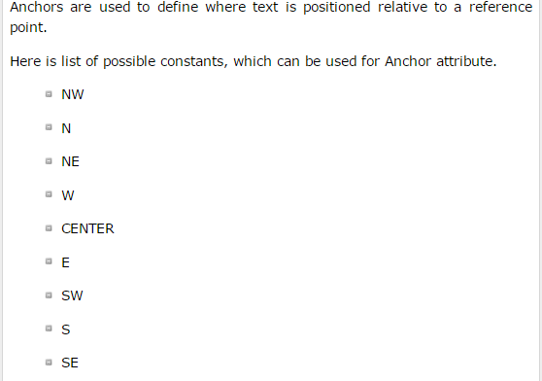
Anchors

Slide 12
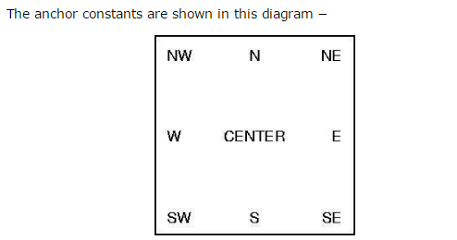
For example, if you use CENTER as a text anchor, the text will be centered horizontally and vertically around the reference point.
Anchor NW will position the text so that the reference point coincides with the northwest (top left) corner of the box containing the text.
Anchor W will center the text vertically around the reference point, with the left edge of the text box passing through that point, and so on.
If you create a small widget inside a large frame and use the anchor=SE option, the widget will be placed in the bottom right corner of the frame. If you used anchor=N instead, the widget would be centered along the top edge.

Slide 13
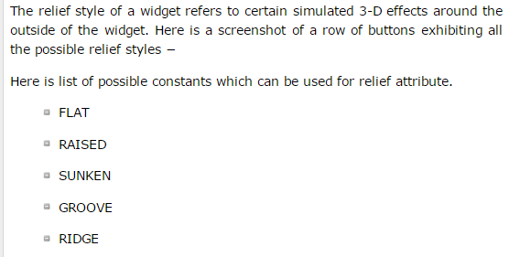
Python Tkinter Relief styles

Slide 14
Geometry Management
All Tkinter widgets have access to specific geometry management methods, which have the purpose of organizing widgets throughout the parent widget area. Tkinter exposes the following geometry manager classes: pack, grid, and place.
  The pack() Method - This geometry manager organizes widgets in blocks before placing them in the parent widget.
  The grid() Method - This geometry manager organizes widgets in a table-like structure in the parent widget.
  The place() Method -This geometry manager organizes widgets by placing them in a specific position in the parent widget.

Slide 15
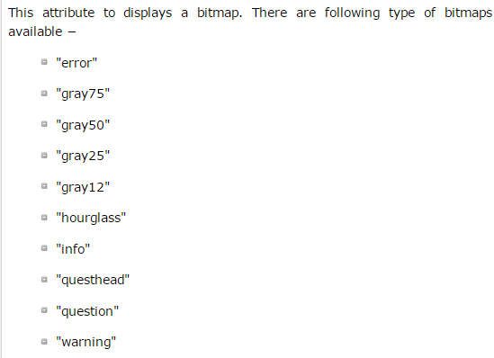
Python Tkinter Bitmaps

Slide 16
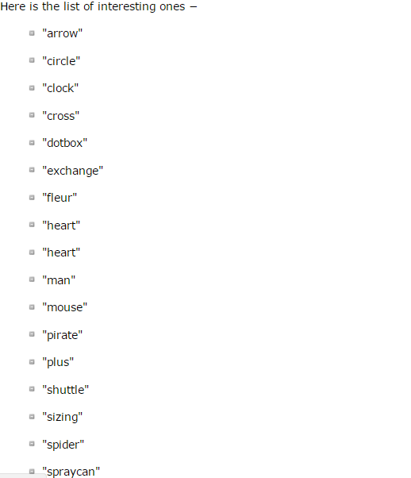
Python Tkinter Cursors

Slide 17
Button
The Button widget is used to add buttons in a Python application. These buttons can display text or images that convey the purpose of the buttons. You can attach a function or a method to a button which is called automatically when you click the button.
Syntax
Here is the simple syntax to create this widget −
w = Button ( master, option=value, ... )
Parameters
master: This represents the parent window.
options: Here is the list of most commonly used options for this widget. These options can be used as key-value pairs separated by commas.

Slide 18
Canvas
The Canvas is a rectangular area intended for drawing pictures or other complex layouts. You can place graphics, text, widgets or frames on a Canvas.
w = Canvas ( master, option=value, ... )
Parameters:
master: This represents the parent window.
options: Here is the list of most commonly used options for this widget. These options can be used as key-value pairs separated by commas.

Slide 19
Button
Program2
import Tkinter
import tkMessageBox
top = Tkinter.Tk()
def helloCallBack():
tkMessageBox.showinfo( "Hello Python", "Hello World")
B = Tkinter.Button(top, text ="Hello", command = helloCallBack)
B.pack()
top.mainloop()

Slide 20
canvas.create_image
canvas.create_arc
canvas.create_oval
canvas.create_polygon

Slide 21
Canvas
program3
import Tkinter
import tkMessageBox
top = Tkinter.Tk()
C = Tkinter.Canvas(top, bg="blue", height=250, width=300)
coord = 10, 50, 240, 210
arc = C.create_arc(coord, start=0, extent=150, fill="red")
C.pack()
top.mainloop()

Slide 22
Check button
The Checkbutton widget is used to display a number of options to a user as toggle buttons. The user can then select one or more options by clicking the button corresponding to each option.
You can also display images in place of text.
Syntax
Here is the simple syntax to create this widget −
w = Checkbutton ( master, option, ... )Parameters:
master: This represents the parent window.
options: Here is the list of most commonly used options for this widget. These options can be used as key-value pairs separated by commas.

Slide 23
The Variable Classes (BooleanVar, DoubleVar, IntVar, StringVar)
If you program Tk using the Tcl language, you can ask the system to let you know when a variable is changed. The Tk toolkit can use this feature, called tracing, to update certain widgets when an associated variable is modified.
There’s no way to track changes to Python variables, but Tkinter allows you to create variable wrappers that can be used wherever Tk can use a traced Tcl variable.

Slide 24
Check button
from Tkinter import *
import tkMessageBox
import Tkinter
top = Tkinter.Tk()
CheckVar1 = IntVar()
CheckVar2 = IntVar()
C1 = Checkbutton(top, text = "Music", variable = CheckVar1, onvalue = 1, offvalue = 0, height=5, width = 20)
C2 = Checkbutton(top, text = "Video", variable = CheckVar2, onvalue = 1, offvalue = 0, height=15, width = 50)
C1.pack()
C2.pack()
top.mainloop()

Slide 25
Entry
The Entry widget is used to accept single-line text strings from a user.
If you want to display multiple lines of text that can be edited, then you should use the Text widget.
If you want to display one or more lines of text that cannot be modified by the user, then you should use the Label widget.
Syntax
Here is the simple syntax to create this widget −
w = Entry( master, option, ... )
Parameters:
master: This represents the parent window.
options: Here is the list of most commonly used options for this widget. These options can be used as key-value pairs separated by commas.

Slide 26
Entry
program4
from Tkinter import *
top = Tk()
L1 = Label(top, text="User Name")
L1.pack( side = LEFT)
E1 = Entry(top, bd =5)
E1.pack(side = RIGHT)
top.mainloop()

Slide 27
Listbox
The Listbox widget is used to display a list of items from which a user can select a number of items
Syntax
Here is the simple syntax to create this widget −
w = Listbox ( master, option, ... )
Parameters
master: This represents the parent window.
options: Here is the list of most commonly used options for this widget. These options can be used as key-value pairs separated by commas.

Slide 28
Listbox
from Tkinter import *
import tkMessageBox
import Tkinter
top = Tk()
Lb1 = Listbox(top)
Lb1.insert(1, "Python")
Lb1.insert(2, "Perl")
Lb1.insert(3, "C")
Lb1.insert(4, "PHP")
Lb1.insert(5, "JSP")
Lb1.insert(6, "Ruby")
Lb1.pack()
top.mainloop()
Program6

Slide 29
Frame
from Tkinter import *
root = Tk()
frame = Frame(root)
frame.pack()
bottomframe = Frame(root)
bottomframe.pack( side = BOTTOM )
  redbutton = Button(frame, text="Red", fg="red")
  redbutton.pack( side = LEFT)
  greenbutton = Button(frame, text="Brown", fg="brown")
  greenbutton.pack( side = LEFT )
  bluebutton = Button(frame, text="Blue", fg="blue")
  bluebutton.pack( side = LEFT )
blackbutton = Button(bottomframe, text="Black", fg="black")
blackbutton.pack( side = BOTTOM)
root.mainloop()
program5

Slide 30
Radiobutton
from Tkinter import *
def sel():
selection = "You selected the option " + str(var.get())
label.config(text = selection)
root = Tk()
var = IntVar()
R1 = Radiobutton(root, text="Option 1", variable=var, value=1, command=sel)
R1.pack( anchor = W )
R2 = Radiobutton(root, text="Option 2", variable=var, value=2, command=sel)
R2.pack( anchor = W )
R3 = Radiobutton(root, text="Option 3", variable=var, value=3, command=sel)
R3.pack( anchor = W)
label = Label(root)
label.pack()
root.mainloop()
program7

Slide 31
Menubutton
from Tkinter import *
import tkMessageBox
import Tkinter
top = Tk()
mb= Menubutton ( top, text="condiments“,relief=RAISED )
mb.grid()
mb.menu = Menu ( mb, tearoff = 0 )
mb["menu"] = mb.menu
mayoVar = IntVar()
ketchVar = IntVar()
mb.menu.add_checkbutton ( label="mayo",
variable=mayoVar )
mb.menu.add_checkbutton ( label="ketchup",
variable=ketchVar )
mb.pack()
top.mainloop()
program8

Slide 32
Bring Image
# Putting a gif image on a canvas with Tkinter
from Tkinter import *
root=Tk()
# create the canvas, size in pixels
canvas = Canvas(width = 300, height = 200, bg = 'yellow')
# pack the canvas into a frame/form
canvas.pack(expand = YES, fill = BOTH)
# load the .gif image file
# put in your own gif file here, may need to add full path
gif1 = PhotoImage(file = 'dw.gif')
# put gif image on canvas
# pic's upper left corner (NW) on the canvas is at x=50 y=10
canvas.create_image(50, 10, image = gif1, anchor = NW)
# run it ...
root.mainloop()
Program

Slide 33
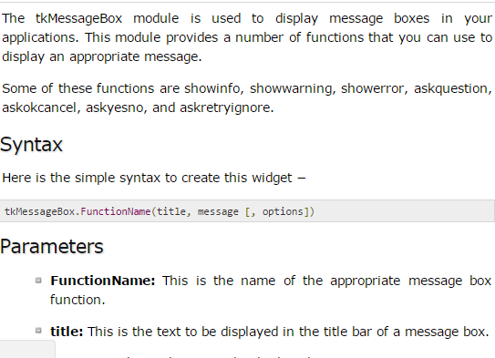
tkMessageBox

Slide 34
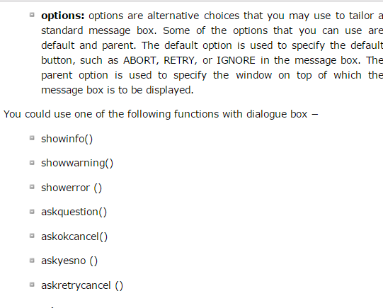

Slide 35
